Slide 1

1
Final Project Report
MegaStock
A Stock Screening and Recommendation System
-- Based on Scala
BY Group 9
Xuzheng Lu, Han Wang, Yezi He, Hai Chi
11/26/2019

Slide 2
2
Contents
01
Part One
Introduction
02
Part Two
Evaluation of Scala
03
Part Three
Project Background
04
Part Four
Project Vision
05
Part Five
Presentation of Demo

Slide 3
3
01
Part One
Introduction

Slide 4
4
Overview of Scala
Scala is short for Scalable Language, it is a multi-paradigm programming language
Martin Odersky of the Federal Institute of Technology Lausanne (EPFL) started designing Scala in 2001 based on the work of Funnel. As of September 2009, the latest version is version 2.7.6.
Object-oriented
Support by Abstract Data Type、Inheritance、Encapsulation、Polymorphism
Functional programming
Support by Closures、Recursive Expression、Anonymous Functions
Concurrency
Support by Semaphore Supporting、Monitors、Message passing

Slide 5
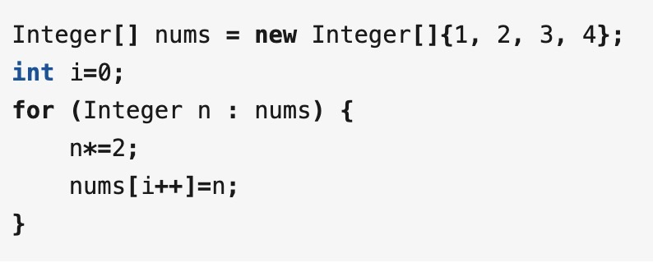
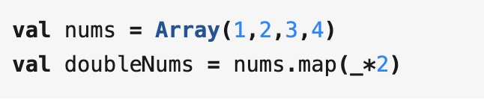
5
Functional programming
Imperative: Command the “machine” how to do things,
it will be implemented according to your command (eg.Java)
Functional programming: Tell the "machine" what you want
and let the machine figure out how to do it (eg.Scala)
Concept Map

Slide 6
6
Four major characteristics
Immutable data
A variable is assigned only once. If you want to change its value, create a new one.
Functions are first class methods
Functions can be used like ordinary variables. Functions can be created, modified, and passed as variables, returned, or nested within functions.
Referential transparency
The function‘s operation does not depend on external variables or “state”, only on the input parameters, as long as the parameters are the same, the return value obtained by calling the function is always the same. Naturally adapt to concurrent programming, because the results of calling functions are consistent, there is no need to lock at all, and there is no deadlock problem.
Tail recursion
Function calls must be pushed to the stack to save the scene. If the recursion level is too deep, too many pushes will cause performance problems. Therefore, tail recursion can optimize it, and the stack is reused each time to recur, improving performance.

Slide 7

7
framework based on Scala
Spark, originally a distributed, in-memory, streaming computing engine developed by the AMPLab laboratory of the University of Berkeley in 2009, was originally designed to perform a series of processing tasks for large amounts of data at high speed.
Spark itself has a great advantage in operations that require a large number of iterations. Compared to the goal of "one stack to rule them all", in fact, Spark has become a unified platform for fast processing of lightweight big data.
Spark is based on in-memory computing, which improves the real-time performance of data processing in a big data environment, while ensuring high fault tolerance and high scalability, allowing users to deploy Spark on a large number of cheap hardware to form clusters.
Compared to MapReduce, Spark is more efficient and has lower latency in batch processing due to its scalability, in-memory-based computing, and it has the advantages of being able to directly read and write data in any format on Hadoop.

Slide 8
8
02
Part Four
Evaluation of Scala

Slide 9
9
Evaluation of Scala
1
User Scale
Measured by the TIOBE Programming Community Index
TIOBE is an indicator of the popularity of programming languages. The ratings are based on the number of skilled engineers world-wide, courses and third party vendors.
Scala ranked 30th, with 0.421% rating.
Measured by the PYPL (PopularitY of Programming Language)
The PYPL Index is created by analyzing how often language tutorials are searched on Google.
Scala ranked 16th.
Measured by Ranking Programming Languages by GitHub Users
The project finds trends in popularity amongst programming languages, by analyzing over 1.25 billion events from the public GitHub timeline and figuring out how many users each language has.
Scala ranked 17th, with 0.78% Monthly Active Users and 81K repositories on GitHub.
Measured by Redmonk Programming Language Rankings
Redmonk is based on GitHub and Stack Overflow.
Scala ranked 13th in the last quarter, and the ranking is stable during last seven years (12 -> 13)

Slide 10
10
Evaluation of Scala
2
Applicability
Measured by the number of projects on GitHub
Field | scala | python | Java | C++ | C
Deep learning | 89 | 21301 | 631 | 874 | 202
Machine learning | 656 | 45173 | 4050 | 2181 | 584
Data analysis | 527 | 13755 | 2628 | 1177 | 589
Data science | 105 | 9636 | 754 | 304 | 128
Data mining | 149 | 5623 | 1896 | 378 | 123
Artificial Intelligence | 36 | 5783 | 2747 | 1143 | 254
Networking | 509 | 49786 | 20167 | 12194 | 9474
Graphics | 78 | 3127 | 4702 | 11648 | 5592
Software | 354 | 19101 | 35801 | 13182 | 9096
Systems | 1485 | 44370 | 54473 | 25411 | 34032
Algorithms | 1755 | 59101 | 58578 | 42398 | 17130
Distributed systems | 193 | 1481 | 4529 | 739 | 660
Databases | 687 | 23776 | 32552 | 4176 | 2591
Scientific computing | 8 | 361 | 43 | 173 | 83

Slide 11
11
Evaluation of Scala
3
Resources
Measured by library databases (key word: Scala)
Engineering Village: Scala - 2485 items (Java - 53482)
IEEE/IEE Electronic Library: Scala - 455 items (Java - 24284)
Inspec: Scala - 1781 items (Java - 41910)
Papers on arXiv.org: Scala - 255 items (Java - 276)
Measured by Microsoft Docs (key word: Scala)
110 documents for Scala (89640 for Java)
Measured by third-party libraries
Libraries of Java are supported in Scala
To the Java virtual machine (JVM), Scala code and Java code are indistinguishable. The only difference is one extra runtime library, scala-library.jar.

Slide 12
12
Evaluation of Scala
4
Efficiency
Measured by running algorithms on LeetCode
Run Time
Name of Problem | Scala | Python3 | C++ | Java
Two Sum | 288ms | 60ms | 12ms | 2ms
Climbing Stairs | 204ms | 36ms | 1ms | 1ms
Most Common Word | 324ms | 20ms | 4ms | 4ms
Space Usage
Name of Problem | Scala | Python3 | C++ | Java
Two Sum | 48.1MB | 15MB | 10MB | 37.9MB
Climbing Stairs | 39MB | 13.8MB | 8.2MB | 32.9MB
Most Common Word | 47.1MB | 11.9MB | 8.9MB | 36.4MB

Slide 13
13
03
Part Two
Project Background

Slide 14
Why Chinese Stock Market?
14
Daily Limit System - Limit Up & Limit Down
The Chinese market has a large number of individual investors who need information
Stock selection recommendation software in the market is generally implemented manually, which is expensive

Slide 15
15
What can we do?
A system for stock information displaying and selection recommendation!
Provide users with detailed information of the stock market
Stock information visualization
Stock information statistics and analysis for daily, weekly, monthly, and yearly
Let users know about market trends
Let users know the latest news through notification push
Predict the market and select recommended stocks every day for users

Slide 16

16
How can we make money?
Optimize investment strategies on stocks investment
Increase the annualized rate of return on stocks investment
Fit the needs and requirements of personal stocks investors
Provide users with paid subscription services
Cooperate with quantitative trading companies and investment teams

Slide 17
17
04
Part Three
Project Vision

Slide 18
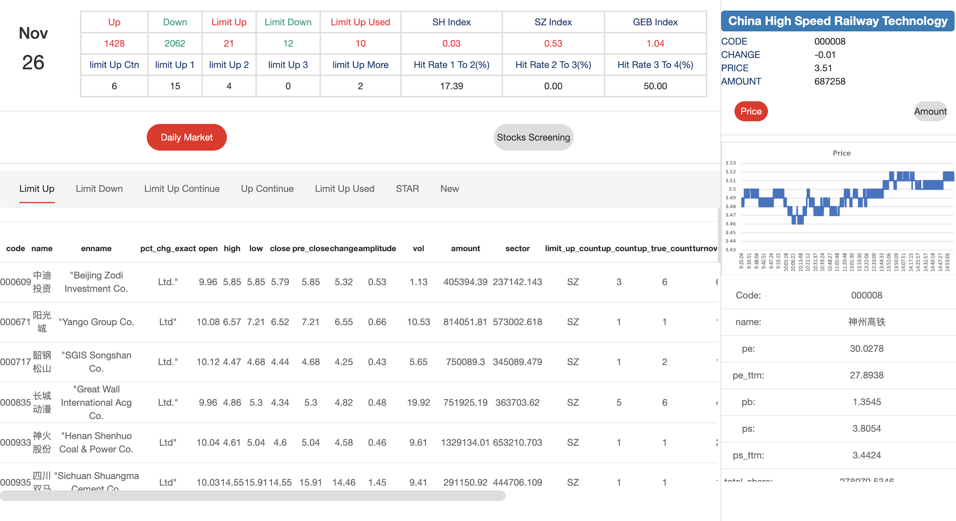
18
Overview of the Project

Slide 19
19
High-Level Architecture
Stocks Data
Source
Daily Data
Spark
(Scala)
Scala
HTML5
Database
Update Database
User
Interface
Push Information
Data Request
Information Processing Module
User Requirements Request
Data Return
Result Return
Push News
Retrieve Information
Retrieve Information
Information
Source
(Google)

Slide 20

20
High-Level Architecture
Database (Spark - Scala)
Store the historical data (original data and processed data)
Store the data and statistics after daily calculation and processing by the system
Respond to data requests from the system
Information Processing Module (Scala)
Obtain daily stock data from data sources (stock exchange)
Update and manage the Database
Calculate and statistics daily stock information - Overview of the market
Recommend stocks to users by several strategies
Send result to the User Interface
User Interface (HTML5)
Display daily stock information
Overview statistics for sentiment analysis of the whole market
Details of selected stock - daily information, charts, and company information
Recommend stocks picking by strategies

Slide 21
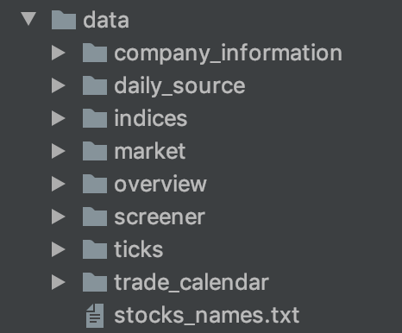
21
Data Analysis
Daily Source Data
Daily stocks and indices information got from the internet
Daily Market Data
Daily data calculated by the Information Processing Module
Overview Data
The trend and statistics information of the market
Screener Data
Stocks selected by strategies
Company Information Data
Financial Data of Listed Companies
Tick Data
Trading information per second of stocks
Trading Calendar
The Calendar of trading days for trading markets

Slide 22
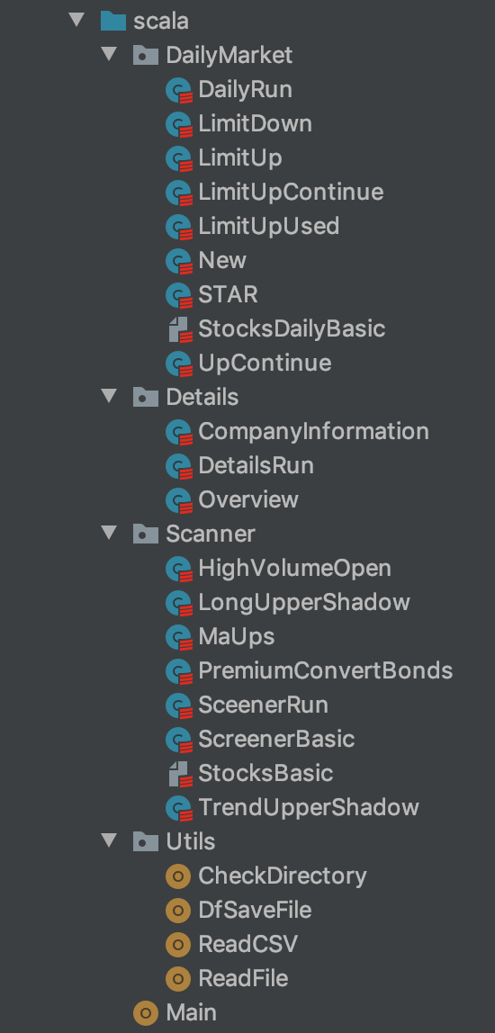
22
Information Processing Module
Daily Market
Calculate and analyze daily data from source data
Details
Overview of the trend and statistics information of the market
Output the information for the selected company
Screener
Calculate stocks recommendation in different strategies
Top-20 stocks for each strategy
Utils
Utilities classes and methods
Main
The object to run the whole program

Slide 23
23
User Interface (HTML5)
Daily Market

Slide 24
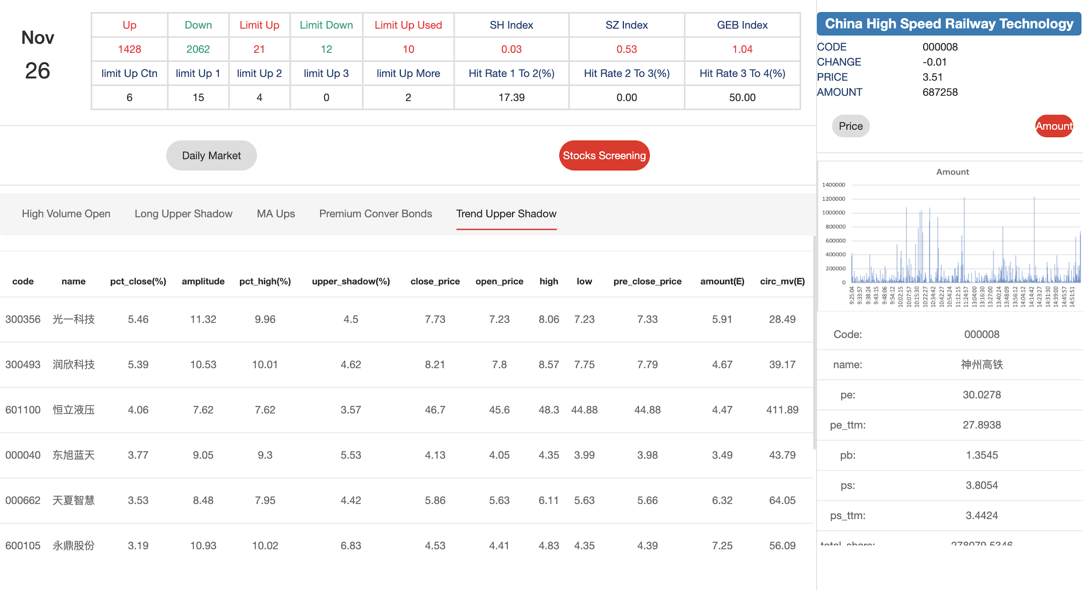
24
User Interface (HTML5)
Stocks Screening

Slide 25
25
05
Part Five
Presentation of Demo

Slide 26
MegaStock
26
https://youtu.be/KtukSv0epIQ

Slide 27
27
Q & A

Slide 28
28
Thanks for listening!

